Slide 1

Dietary quality Environmental Impact
Are they related?
NYOB – DA – 16.02.2024

Slide 2
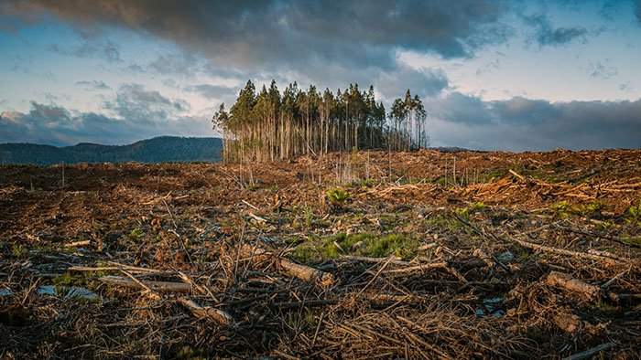
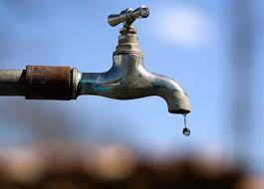
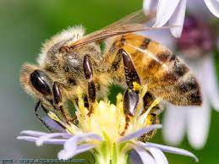

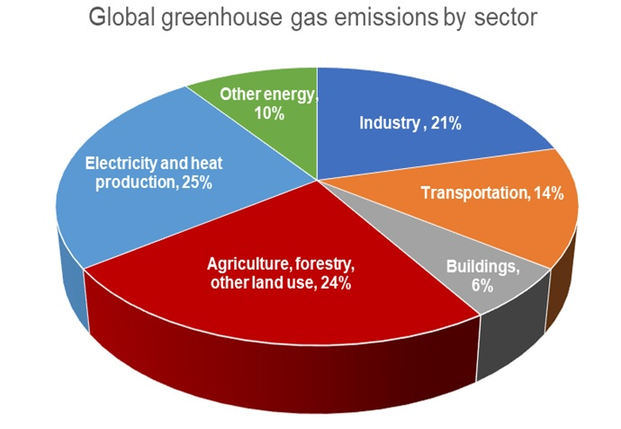
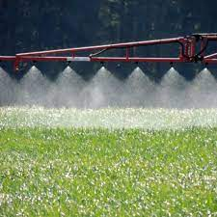
Food has a tremendous environmental footprint

Slide 3
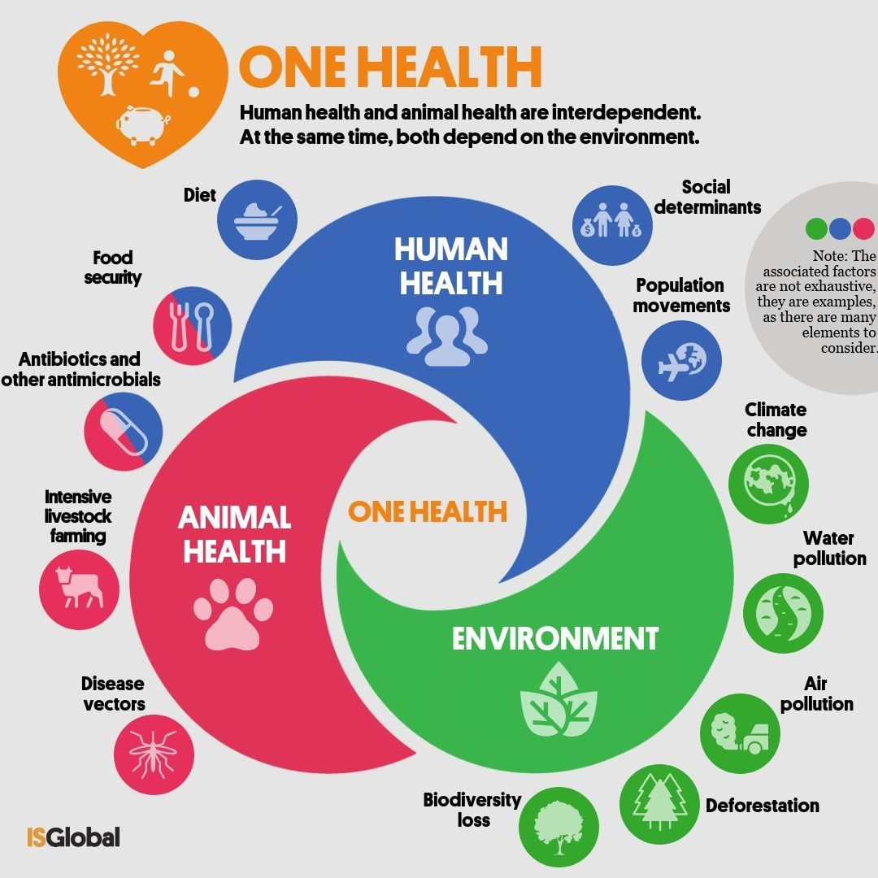

Slide 4

DO NUTRIENTS IMPACT ENVIRONMENTAL FOOTPRINT ?

Slide 5


Data Sources
Environment Indicators (env)
Nutrients (nut)
Food Category (group)
Notes:
agribalyse https://doc.agribalyse.fr/documentation/le-programme-agribalyse/introduction
CIQUAL https://ciqual.anses.fr/#/cms/download/node/20

Slide 6











Food Categories

Slide 7
Sub Questions
Is there any correlation between nutrient richness and environmental impact?
Which food categories are the most impactful?
Which nutritional indicators are the most impactful?

Slide 8
Nutrients
‘Sodium (mg/kg)’,
‘Zinc (mg/kg)’,
‘Vitamin C (mg/kg)’,
‘Vitamin B1 or Thiamin (mg/kg)’,
‘Vitamin B2 or Riboflavin (mg/kg)’,
‘Vitamin B3 or Niacin (mg/kg)’,
‘Vitamin B6 (mg/kg)’,
‘Vitamin B9 or Folate (µg/kg)’
‘Calcium (mg/kg)’,
‘Iron (mg/kg)’,
‘Magnesium (mg/kg)’,
‘Phosphorus (mg/kg)’,
‘Potassium (mg/kg)’,
‘Sodium (mg/kg)’,
‘Zinc (mg/kg)’,
‘Vitamin C (mg/kg)’,
‘Vitamin B1 or Thiamin (mg/kg)’,
‘Vitamin B2 or Riboflavin (mg/kg)’,
‘Vitamin B3 or Niacin (mg/kg)’,
‘Vitamin B6 (mg/kg)’,
‘Vitamin B9 or Folate (µg/kg)’
Energy (kJ/kg)
‘Protein (g/kg)’,
‘Carbohydrate (g/kg)’,
‘Fat (g/kg)’,
‘Sugars (g/kg)’,
‘Fibres (g/kg)’,
‘Ash (g/kg)’,
‘Alcohol (g/kg)’,
‘FA saturated (g/kg)’,
‘FA mono (g/kg)’,
‘FA poly (g/kg)’,
‘Salt (g/kg)’,
No interaction (<2) | Low interaction) (2 to 3) | High (>3 interactions)
Energy (kJ/kg) ‘Sodium (mg/kg)’‘ Vitamin C (mg/kg)’ ‘ Sodium (mg/kg)’ Calcium (mg/kg) Salt (g/kg) FA mono (g/kg) FA saturated (g/kg) Calcium (mg/kg) | Fat (g/kg) Water (g/kg) Fibres (g/kg) Ash (g/kg) FA poly (g/kg) Iron (mg/kg) Phosphorus (mg/kg) Vitamin B1 Vitamin B2 | FA poly (g/kg) Sugars (g/kg) Carbohydrate (g/kg) Magnesium (mg/kg) Potassium (mg/kg) Zinc (mg/kg) Protein (g/kg) Vitamin B3 or Niacin (mg/kg)

Slide 9
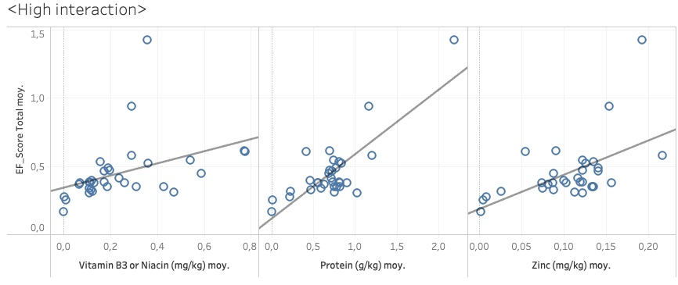
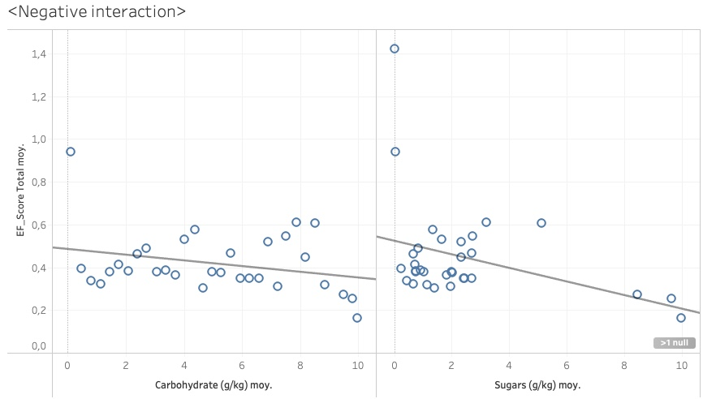
Some Nutrients DO interact with footprint
Acceptable predictive model 20% fitness and accuracy

Slide 10
Was this predictible?
Protein and zinc are more present in meat/fish derivatives
But so are Saturated Fatty Acid and Iron

Slide 11
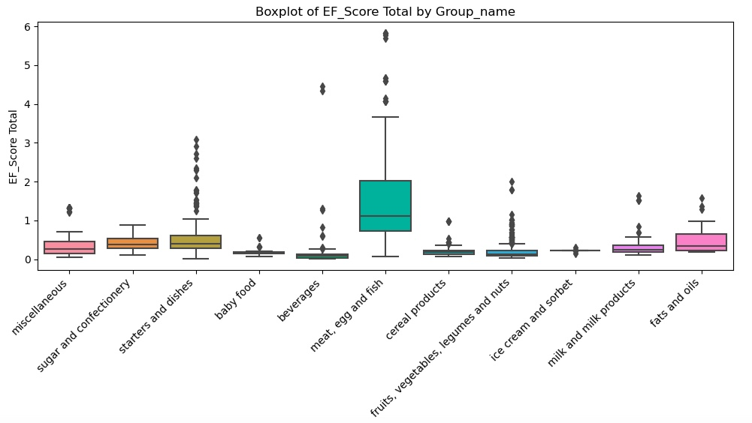
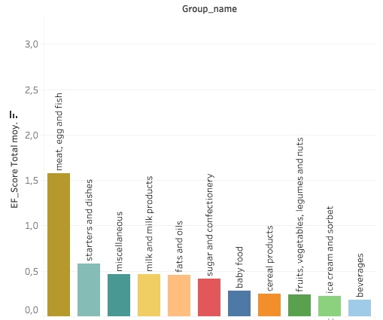
Food Groups
Correlations are too low
Cannot predict Environmental Footprint

Slide 12
Was this predictible?
Those groups were made for different purposes and are internally quite heterogeneous in dietary quality

Slide 13

Is there more to squeeze out this df ?
(nut) and (group) interaction
(group) better grouping (word analysis)
Other (env) factors: mineral use, ecotoxicity…

Slide 14

Food for thought
Situation in a diet pattern ?
Linking health to environment footprint
Be aware of footprint estimate limitations (biodiversity pressure, carbon storage in soils, co-products in agri food industries, degradation of pesticides, spatialization of water)

Slide 15
THANK YOU
Don’t forget to eat apples

Slide 16
Sources
The analysis of agricultural systems according to the Agribalyse® methodology is greatly facilitated by the use of the MEANS-InOut software from INRAE-Cirad upstream of SimaPro. The MEANS-InOut software makes it possible to describe agricultural technical itineraries; it is available online after subscribing to a service contract. To find out more: https://www.inrae.fr/means
DQR :https://doc.agribalyse.fr/documentation/les-donnees/methodologie-acv
CIQUAL codes: https://ciqual.anses.fr/cms/sites/default/files/inline-files/Table%20Ciqual%202020_doc_XML_ENG_2020%2007%2007.pdf

Slide 17
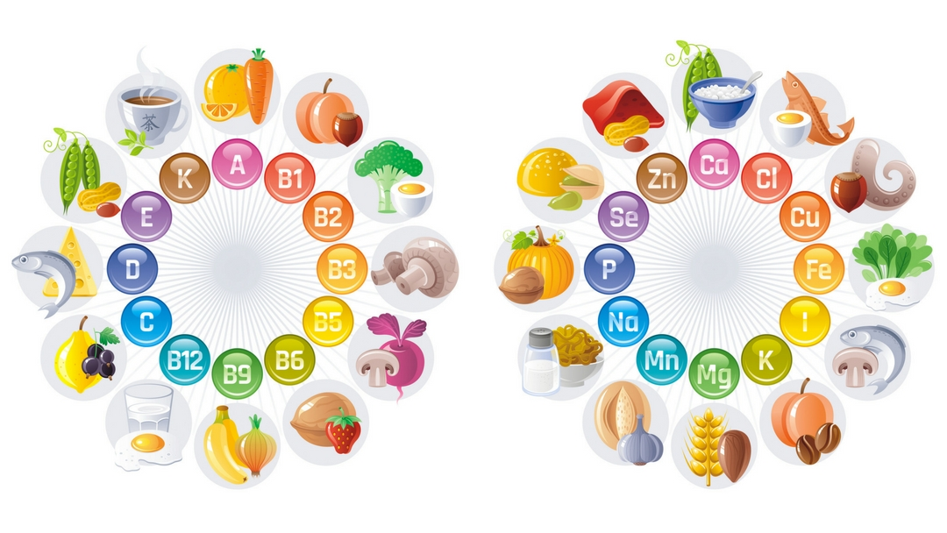
Nutrients

Slide 18
